Slide 1
Cmda 3654 final project
Ariel Lu, Ronald Lee, & Amanda Marousis
Team 7

Slide 2
Executive Summary
Goals:
  To analyze various factors that contribute to winning a game in NBA
  Create model that best fits our data
  Determine which are most/least effective
  Keep factors that are effective

Slide 3
Project Description
2013 – 2014 NBA season
Factors
  Field Goal Percentage (FG%)
  3-Point Percentage (3P%)
  Free Throw Percentage (FT%)
  Rebounds Per Game (REB)
  Assists Per Game (AST)
  Steals Per Game (STL)
  Points Per Game (PTS)
  Response: # of wins per season

Slide 4
Measurement of Factors
FG%, 3P%, FT% each calculated by counting total made and dividing by total shots
REB, AST, STL, PTS are each an average of how many a player has in a game over a season

Slide 5
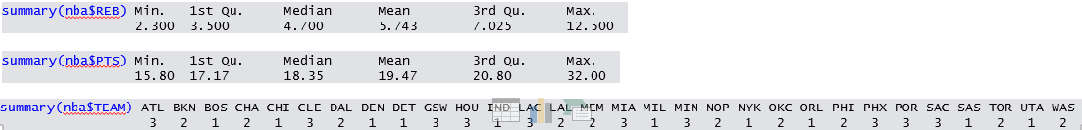
Data Analytics (numerical summaries)
summary(nba$FG.) Min. 1st Qu. Median Mean 3rd Qu. Max.
35.40 43.08 45.35 46.30 49.62 59.10

Slide 6
Reshaping of Data
We used MERGE technique
Two datasets
  1. Players, Team Names (abbreviated), 8 Factors
  2. Full Team Names, Number of Wins Per Team
Mapped Team Names (abbr.) and Full Team Names
Merged datasets through Team Names (abbr.)

Slide 7
Treatment to Missing Data
No missing data because we created our own dataset
Method we would have used would be averaging
  Take an average of the data for that factor that is not missing and use that where missing
  Observations for each factor did not have a very big range → averaging would not mess with results

Slide 8
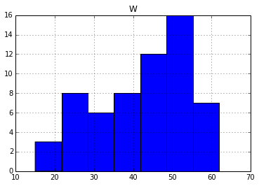
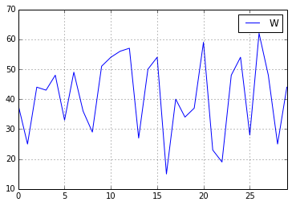
Visualizations
Histogram for
# of wins vs. # of teams
Line graph for
Teams vs. # of wins
# of teams
# of wins
# of wins
Teams

Slide 9
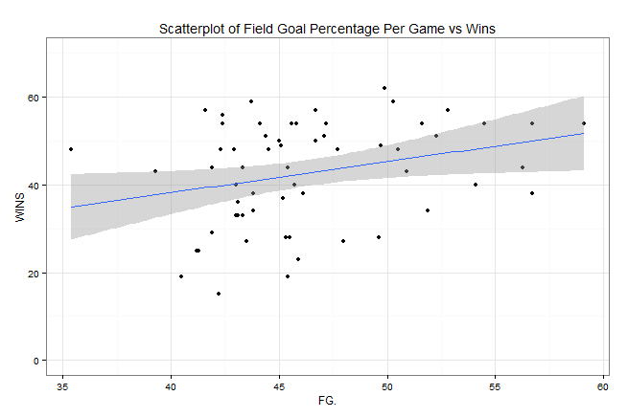
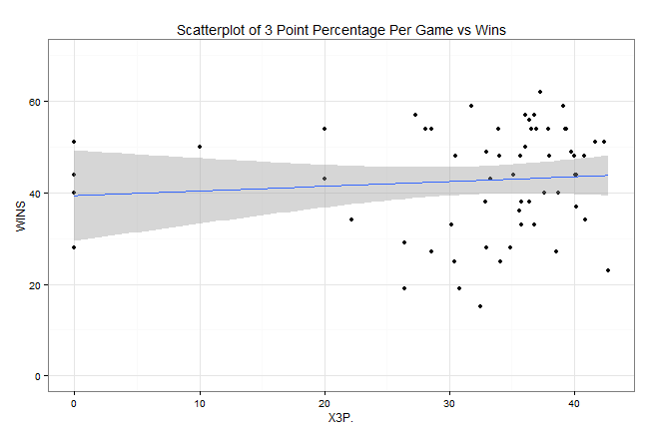
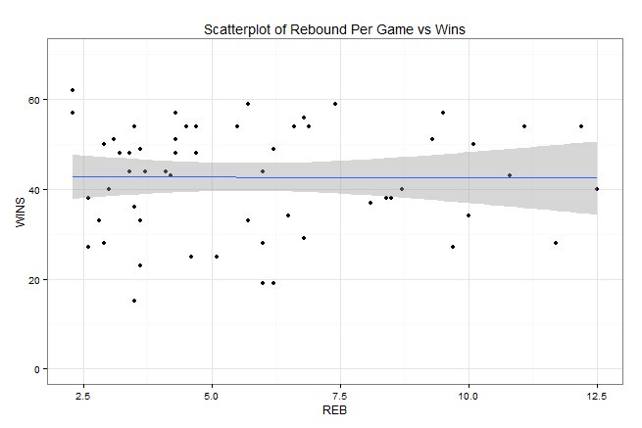
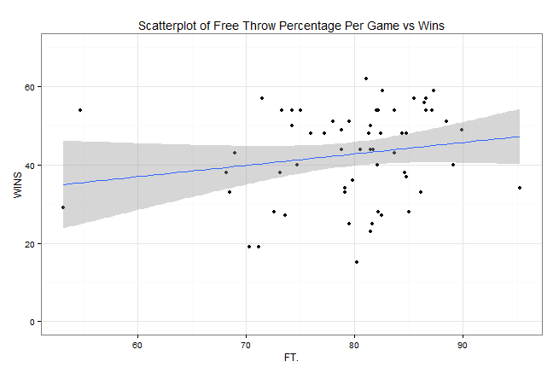
Visualizations

Slide 10
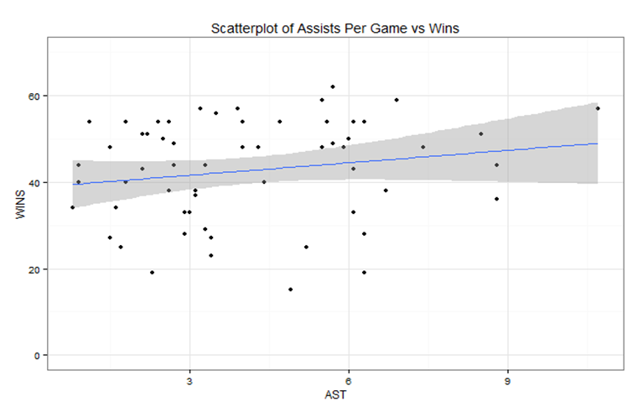
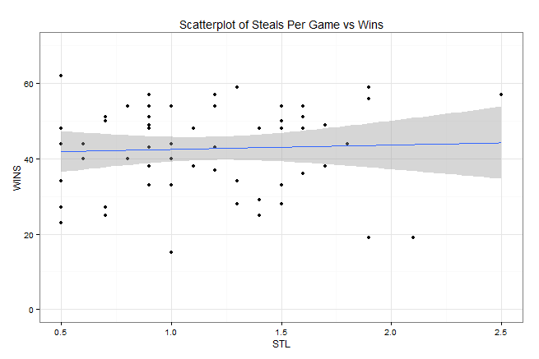
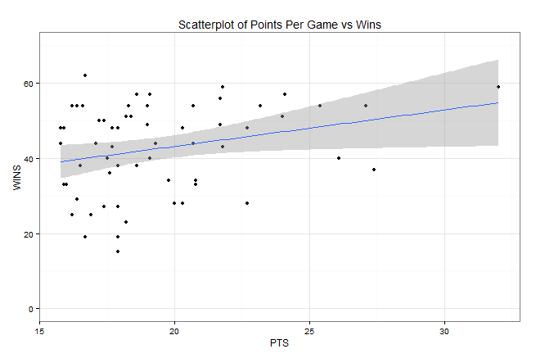
Visualizations

Slide 11
Machine Learning Algorithm
Stepwise regression
Because our # of wins is a numerical variable, our goal is to build a linear regression model for predicting the # of wins
Features: FG%, 3P%, FT%, REB, AST, STL, PTS
Response: # of wins

Slide 12
Stepwise Model Path
Analysis of Deviance Table
Initial Model:
WINS ~ FG. + X3P. + FT. + REB + AST + STL + PTS
Final Model:
WINS ~ FG. + FT. + AST
Step Df Deviance Resid. Df Resid. Dev AIC
1 46 5523.933 265.9045
2 - REB 1 4.77545 47 5528.708 263.9512
3 - PTS 1 18.89610 48 5547.604 262.1354
4 – STL 1 43.45966 49 5591.064 260.5568
5 - X3P. 1 78.32201 50 5669.386 259.3080
Best Model:
(wins) = -57.9705 + 1.2806(FG%)
+ 0.4379(FT%) + 1.3927(AST)
Call: lm(formula = WINS ~ FG. + FT. + AST)
Residuals: Min 1Q Median 3Q Max
-23.0144 -8.1069 0.9767 8.1284 19.3192
Coefficients:
Estimate Std. Error t value Pr(>|t|)
(Intercept) -57.9705 26.9494 -2.151 0.036327 *
FG. 1.2806 0.3517 3.642 0.000643 ***
FT. 0.4379 0.2078 2.107 0.040179 *
AST 1.3927 0.6648 2.095 0.041258 *
---
Signif. codes: 0 ‘***’ 0.001 ‘**’ 0.01 ‘*’ 0.05 ‘.’ 0.1 ‘ ’ 1
Residual standard error: 10.65 on 50 degrees of freedom
Multiple R-squared: 0.2486, Adjusted R-squared: 0.2036
F-statistic: 5.515 on 3 and 50 DF, p-value: 0.002373

Slide 13
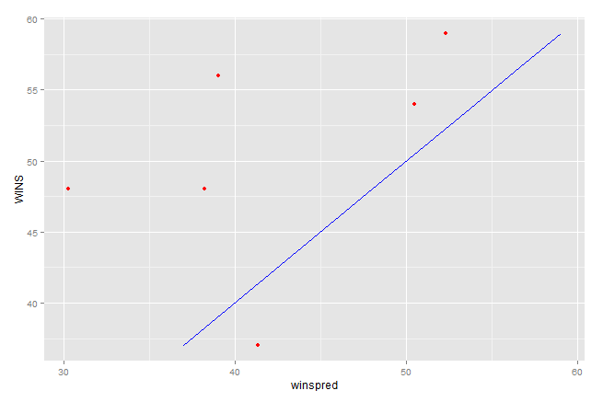
“Actual” vs “Predicted” # of wins

Slide 14
Conclusion
Based on our best model, we see that Field goal percentage, free throw percentage, and assists per game are the most significant factors that predict the number of wins
Based on scatterplots of all the factors vs win, we see that no specific factor is “more” important in influencing the wins of a game

Slide 15
Discussion
Our analysis cannot be generalized to the whole population of NBA players because we only chose approximately 14% of all NBA players
Recommendations:
  Selected players based on points but should have selected randomly
  More observations next time since there are over 400 NBA players

